Slide 1
Cognitive Requirement Engineering for the Next Generation of Ethical Artificial Intelligence Systems
Sabahat Siddique
M24F0023AI003
DR. MUSADAQ MANSOOR
Dr. MAQBOOL KHAN

Slide 2
Introduction
AI is widely used in healthcare, banking, criminal justice, and autonomous systems
Improves efficiency, scalability, and decision-making
Increasing impact on society

Slide 3
Problem Background
AI systems raise ethical concerns:
Bias and discrimination
Lack of transparency
Privacy issues
Weak accountability

Slide 4
Research Gap
Traditional Requirements Engineering (RE):
Focuses on functional & technical requirements
Ignores ethical aspects
Ethical principles remain:
Abstract
Hard to measure
Difficult to implement

Slide 5
Research Objectives
Ethical issues must be addressed early in development
Need to:
Convert ethics into measurable requirements
Validate using real data and models
Maintain traceability

Slide 6
Literature Review
Ferrario et al. (2021) – Ethical Requirements for AI
Identifies key ethical issues in AI systems
Highlights need for ethical requirements in RE
Focus on fairness, transparency, and accountability
Provides conceptual understanding
Gap:
Lacks practical implementation framework
No quantifiable metrics or tool support
Our Work:
Ethical RE framework with lifecycle integration
Web-based validation tool (EthicalReq-AI)

Slide 7
Ahmad et al. (2023) – RE4AI Study
Identifies gaps in Requirements Engineering for AI systems
Focus on missing ethical integration in lifecycle
Highlights lack of structured ethical RE frameworks
Gap:
No practical implementation approach
Our Contribution:
Proposed Ethical RE Framework + Web Tool (EthicalReq-AI)

Slide 8
Ahmad et al. (2023) – Human-Centered AI RE
Key Points:
Examines human-centered AI requirements engineering
Finds weak integration of ethics in development lifecycle
Highlights disconnect between theory and practice
Gap:
No automated or lifecycle-based solution
Our Contribution:
Full lifecycle-based ethical RE integration

Slide 9
Akbarighatar (2025) – Responsible AI Capabilities
Key Points:
Maps Responsible AI principles into system capabilities
Focus on operationalizing ethics
Gap:
Complex decomposition of principles
Our Contribution:
Simple quantifiable ethical requirement templates

Slide 10
Tool Support
Web-based tool: EthicalReq-AI
Features:
Capture ethical requirements
Validate using datasets
Apply fairness & explainability metrics
Maintain traceability

Slide 11
Research Contribution
Bridges gap between theory and practice
Makes ethics:
Measurable
Testable
Traceable
Improves trustworthy AI systems

Slide 12
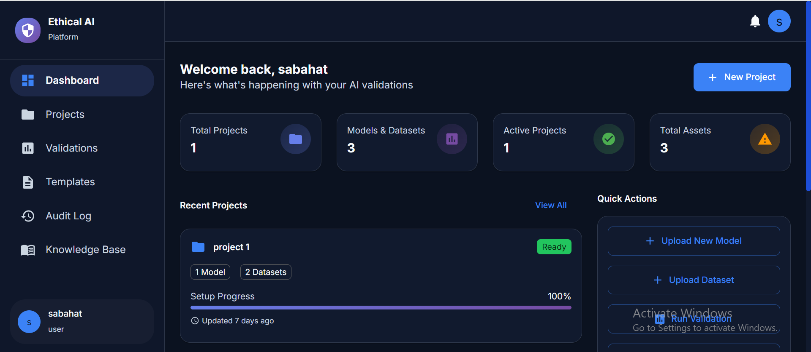
Dashboard

Slide 13
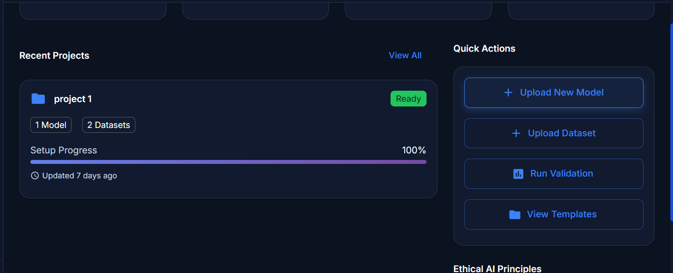
Models & Datasets

Slide 14
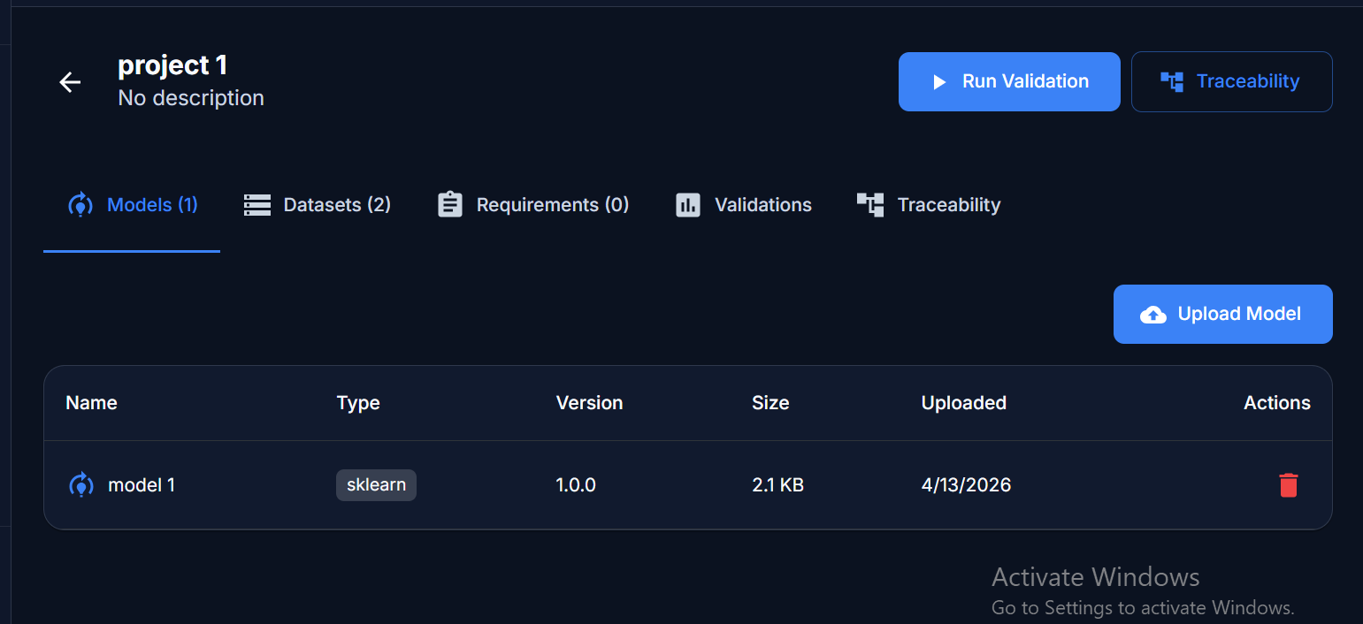
Check Validation

Slide 15
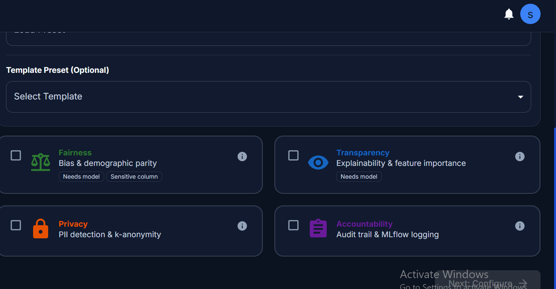
Ethical Issues

Slide 16
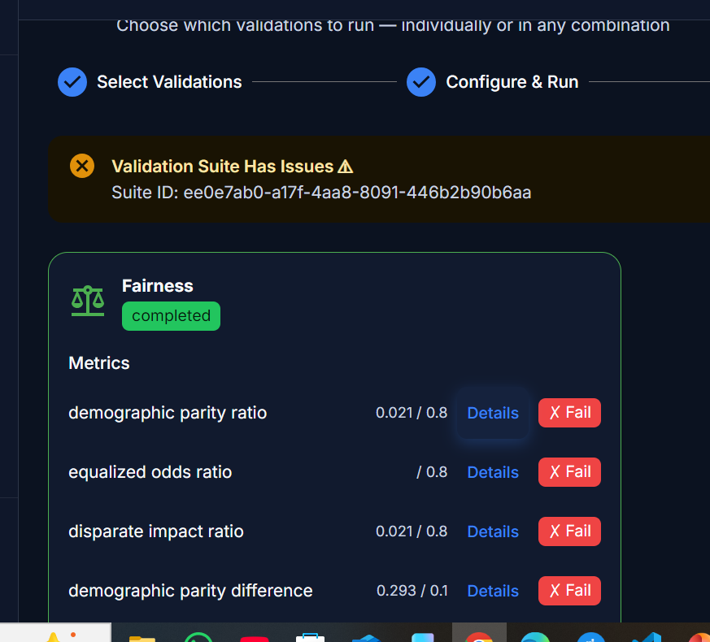
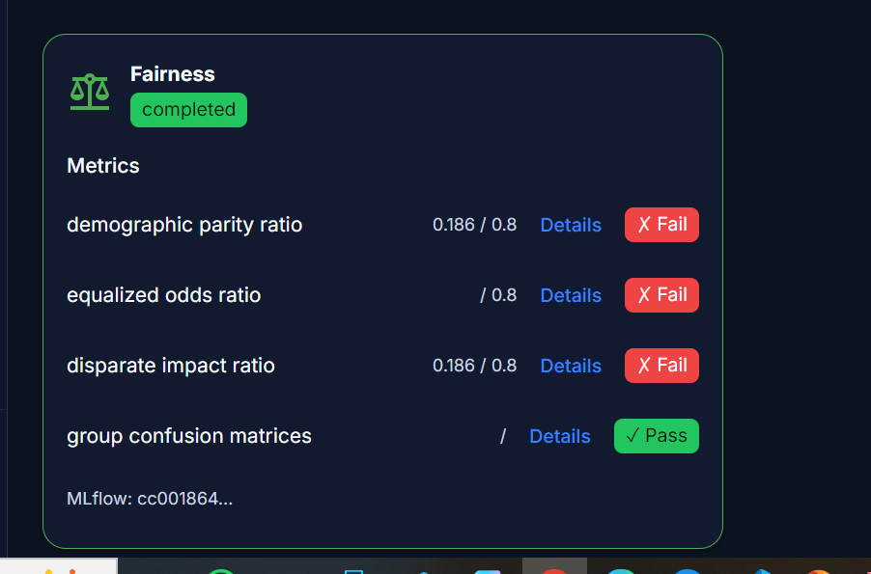
Fairness Results

